Slide 1

The Grid Component Model: an Overview
“Proposal for a Grid Component Model” DPM02
“Basic Features of the Grid Component Model (assessed)” -- DPM04
CoreGrid institute on Programming Models
Ludovic Henrio

Slide 2
Context
“By defining the GCM, the institute aims at the precise specification of an effective Grid Component Model.”
The features are discussed taking Fractal as the reference model, and defined as extensions to the Fractal specification (also relates to CCA, CCM, …)
The institute expects several different implementations of the GCM, not necessarily relying on existing Fractal implementations.

Slide 3
General Features
Component hierarchy
Extensibility of the model
Support for adaptivity
Language neutrality
Interoperability
Reflexivity
Lightweight ➔ portable and compact implementations
Well-defined semantics (allow future formalization)

Slide 4
A Joint partners activity
Centralized by OASIS team (INRIA Sophia)
Strong contribution of University of Pisa (e.g., autonomicity)
And collaboration of INRIA Rennes (communications and MxN case)
Important feedback concerning Grid applications and environments: University of Westminster but also VUA
Common agreement of the WP3
Other related efforts, e.g., interfacing Mocca and GCM (Cyfronet - Krakow)

Slide 5
Outline
A Short Summary of Fractal
Abstract Model of the GCM
Communication, Parallelism and Distribution
Dynamic Controllers
Support for Autonomicity

Slide 6
GCM is Based on Fractal
Fractal provides:
Terminology, API (and ADL) ➔ Interoperability
Hierarchical structure
Separation of concerns
Abstract component model ➔ no constrain on implementation: several implementations exist
Multi-level specification: almost every object is a level 0 Fractal component
  Multi-level specification of the GCM
➔ We focus on the Grid specific extensions of Fractal
}
general features

Slide 7
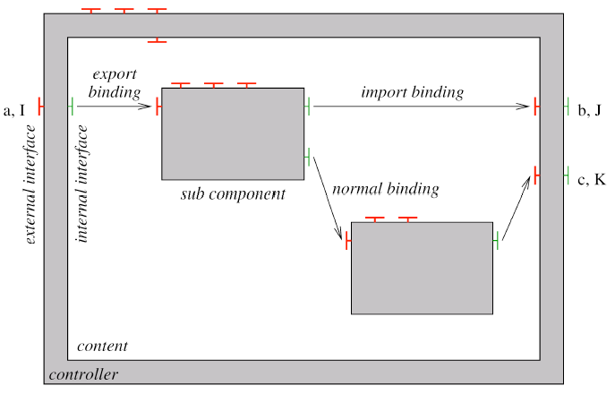
A Fractal Component

Slide 8
Outline
A Short Summary of Fractal
Abstract Model of the GCM
Communication, Parallelism and Distribution
Dynamic Controllers
Support for Autonomicity

Slide 9
Defining and Deploying Components
XML Component Specification
(XML schema or DTD)
Run-Time API defined in several languages
Packaging described as an XML document
  cf. Fractal packaging

Slide 10
Definition / Description of a Component
Definition of Primitive Components
Definition of Composite Components (composition)
Interfaces (ports) : Server, Client / asynchronous method calls, event, stream, etc.
Specification of Grid aspects:
  Parallelism, Distribution, Virtual Nodes,
  Performance Needs, QoS, etc.
Including external references to various specifications:
  Java Interface, C++ .h, Corba IDL, WSDL, etc.

Slide 11
Outline
A Short Summary of Fractal
Abstract Model of the GCM
Communication, Parallelism and Distribution
Dynamic Controllers
Support for Autonomicity

Slide 12
Communications
Semantics should be specified in the interfaces
asynchronous method call is the default
Allow streaming and event-based communications
Implementation details purposely unspecified

Slide 13
Parallel Components: Distribution
Notion of Virtual Nodes ➔ distribution
  Maps the virtual architecture to a physical one
  One can envisage more sophisticated information such as, for instance, topology information, QoS requirements between the nodes, etc.
Parallel components can
  Be distributed or not
  Admit several implementation
  ➔ adaptive implementations

Slide 14
Collective Communications
Fractal type-system
Simple type system
Component type ⬅ types of its interfaces
Interface type :
  Name
  Signature
  Role
  Contingency
  Cardinality extended to support multicast / gathercast

Slide 15
Multicast interfaces
Transform a single invocation into a list of invocations
Multiple invocations
  Parallelism
  Asynchronism
  Dispatch
Data redistribution (invocation parameters)
  Parameterisable distribution function
  Broadcast, scattering
  Dynamic redistribution (dynamic dispatch)
Result = list of results

Slide 16
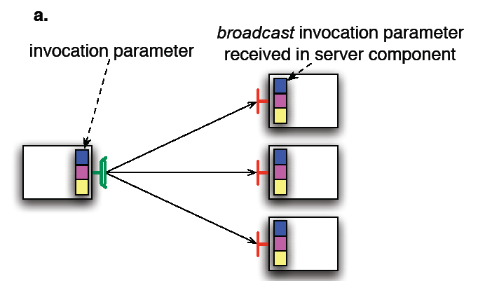
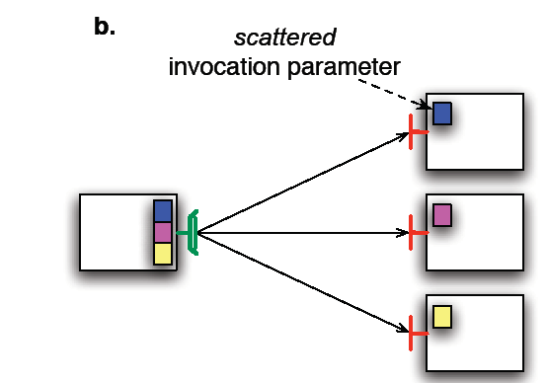

Slide 17
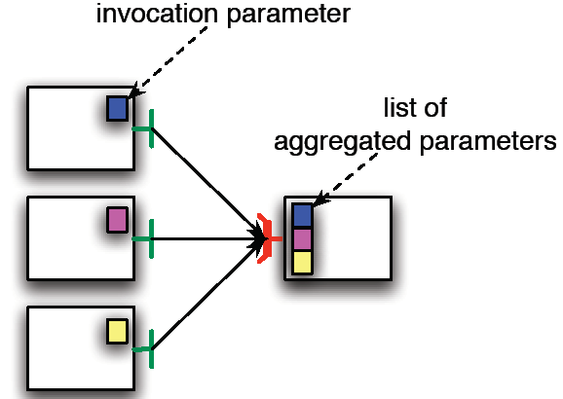
Gathercast interfaces
Transform a list of invocations into a single invocation
Synchronization of incoming invocations
  ~ “join” invocations
  Timeout / drop policy
  Bidirectional bindings (callers ⬄ callee)
Data gathering
  Aggregation of parameters into lists
Redistribution of results
  Redistribution function

Slide 18
Collective interfaces
Multicast / Gathercast / Gathermulticast
Specific API
Allow MxN communications:
  Redistribution and
  direct
  communications

Slide 19
Outline
A Short Summary of Fractal
Abstract Model of the GCM
Communication, Parallelism and Distribution
Dynamic Controllers
Support for Autonomicity

Slide 20
Dynamic Controllers
(components in component’s membrane)
Interest for the GCM:
  Reconfiguration and adaptativity of the membranes
  For autonomic aspects:
  hierarchical composition of
  autonomic aspects
  (also multicast)
  Fractal (GCM) Components
  in the membrane
Apply Fractal specification to the non-functional aspect
  Pluggable NF server interfaces (NF components)
  NF client interfaces

Slide 21
Dynamic Controllers Summary
Adaptativity and autonomicity
Dynamic reconfiguration of the controllers
Called component controller
Better separation of concerns
Modification of the content controller (for the membrane)
Controller components should be lightweight components
Might have restriction on distribution or complexity of component controllers
Conformance levels: component controllers are optional

Slide 22
Outline
A Short Summary of Fractal
Abstract Model of the GCM
Communication, Parallelism and Distribution
Dynamic Controllers
Support for Autonomicity

Slide 23
Autonomicity
Self-Configuring: handles reconfiguration inside itself
Self-Healing: provides its services in spite of failures
Self-Optimising: adapts its configuration and structure in order to achieve the best/required performance.
Self-Protecting: predicts, prevents, detects and identifies attacks, and to protect itself against them.
Open and extensible specification
Several levels of autonomicity depending on:
  autonomic controllers implemented
  autonomicity level implemented by each controller

Slide 24
Specification of Autonomicity
Three levels for autonomicity
  No autonomic control
  Passive autonomic control
  Active autonomic control
API:
Should compose with hierarchy and might use component controllers

Slide 26
Summary / Conclusion
Hierarchical and extensible component model
Support for distribution and extended communication patterns
Multicast/Gathercast specification + implementation: collective communications
« Component Oriented SPMD »
Deployment of components
Dynamic controllers
Autonomicity (passive / active)

Slide 27
Current and Future Works
MxN as an optimization for the coupling of multicast and gathercast
Generalisation of the data distribution and gathering policies for multicast and gathercast (new conditions on typing)
Refinement of the specification and implementation of component controllers
Experiments and validation
➔ a prototype implementation of the GCM under GridCOMP: ProActive/GCM

